Slide 1


Elevating Impact!
Notes:
Assalamualaikum! Good Morning Ladies and Gentlemen!
Im Samihah from Membership Dept. First of all, We would like to thanks Uniten for giving us this opportunity to conduct career talk with your students.
Today me and my colleague Shahirah from certification department will be presenting about iia Malaysia membership and certification programme.
Hope you guys enjoy it.
If you have any question you may stop me or post your question on the chat box and I will attend at the end of my presentation
OK, LETS BEGIN!

Slide 2

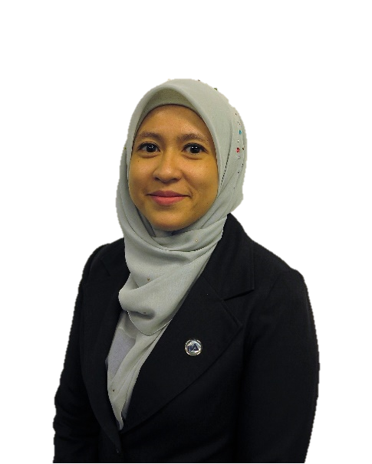
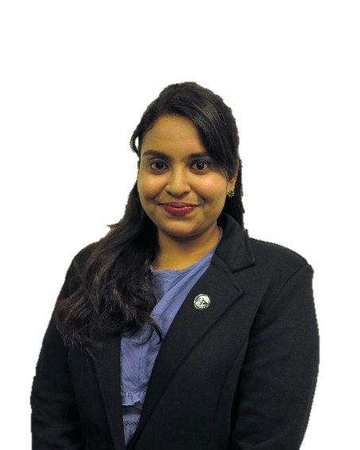
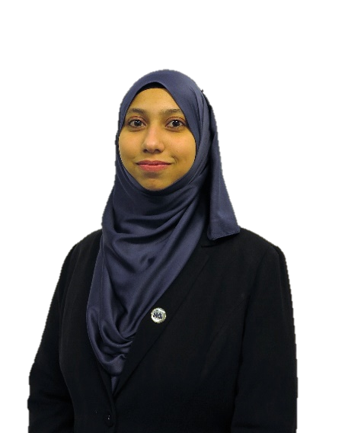
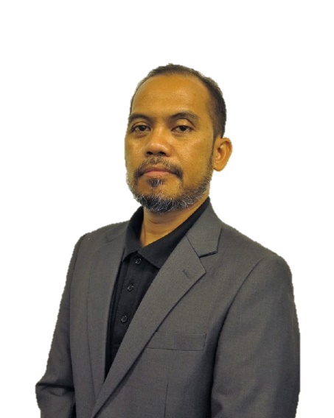
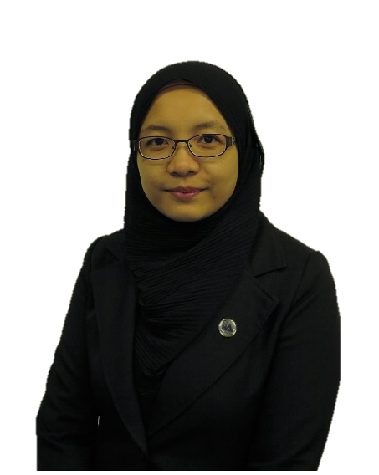
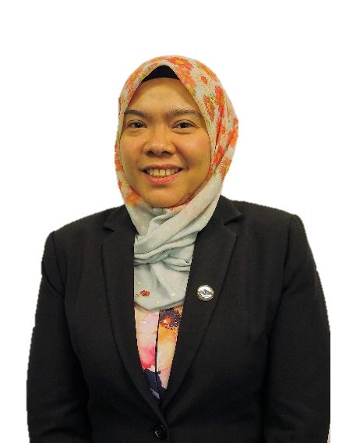
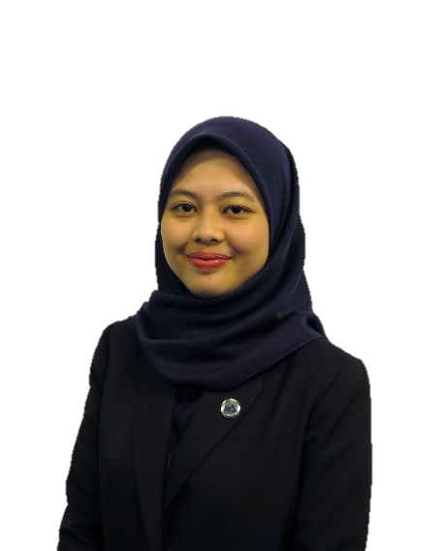
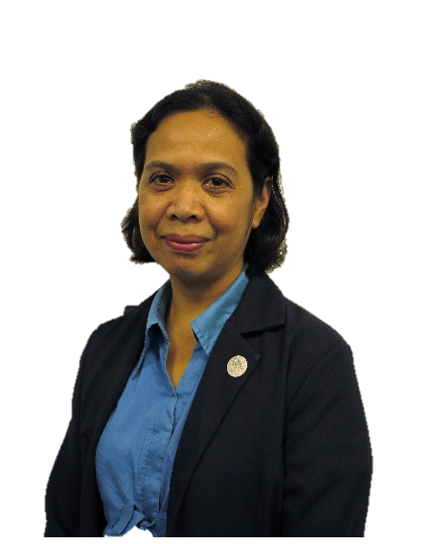
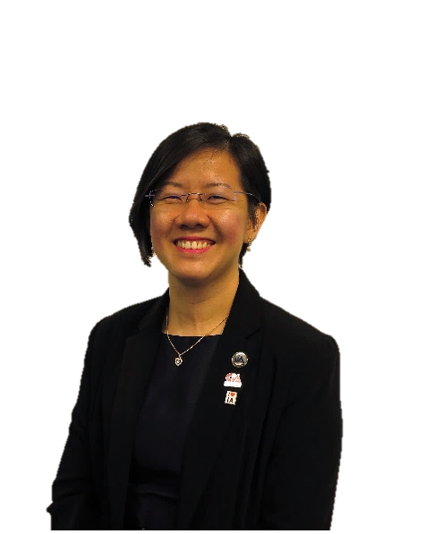
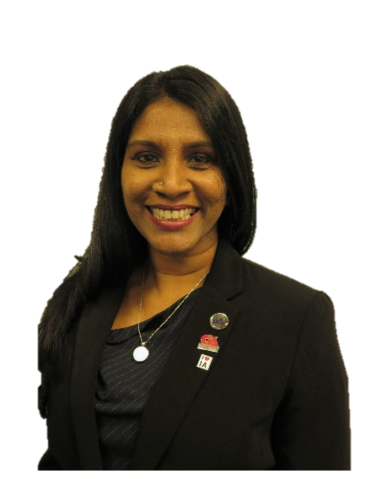
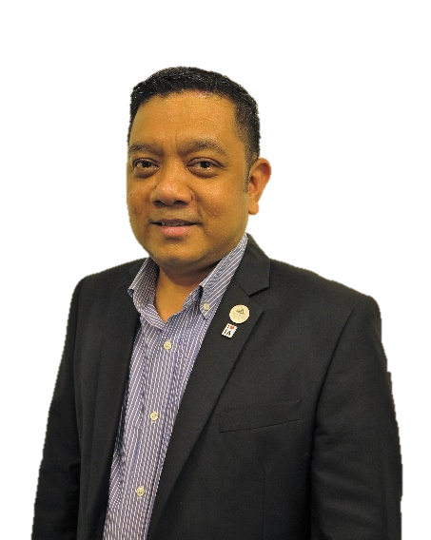
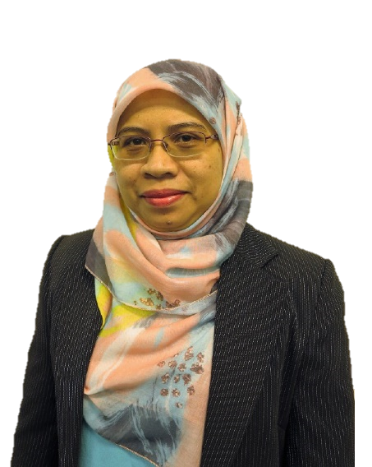

WELCOME
TO THE IIA MALAYSIA
The Institute maintains its motto “Elevating Impact”. The IIA helps internal auditors deliver strategic advantage that drives organizational success
Notes:
Allow me to briefly introduce about IIA Malaysia.
Elevating Impact”. Is our motto to helps internal auditor deliver strategic advantages.

Slide 3







A non-profit professional organisation dedicated to the advancement and the development of the internal audit profession in Malaysia
Affiliated to the Institute of Internal Auditors Inc. (Global IIA), USA, a worldwide body founded in 1941.
1977 - Established as a Chapter of The Institute of Internal Auditors Inc., USA
1988 - Elevated to status of a National Institute
1994 - Incorporated as a Company Limited by Guarantee
ABOUT
THE IIA MALAYSIA
FOLLOW US ON:
Notes:
We has established about 45 years old. We are a non-profit organisation and affiliate to the Institute of internal auditor (IIA Global) in USA.
In 1977 we become a chapter of IIA Global and 1994 as a company limited by guarantee.

Slide 4

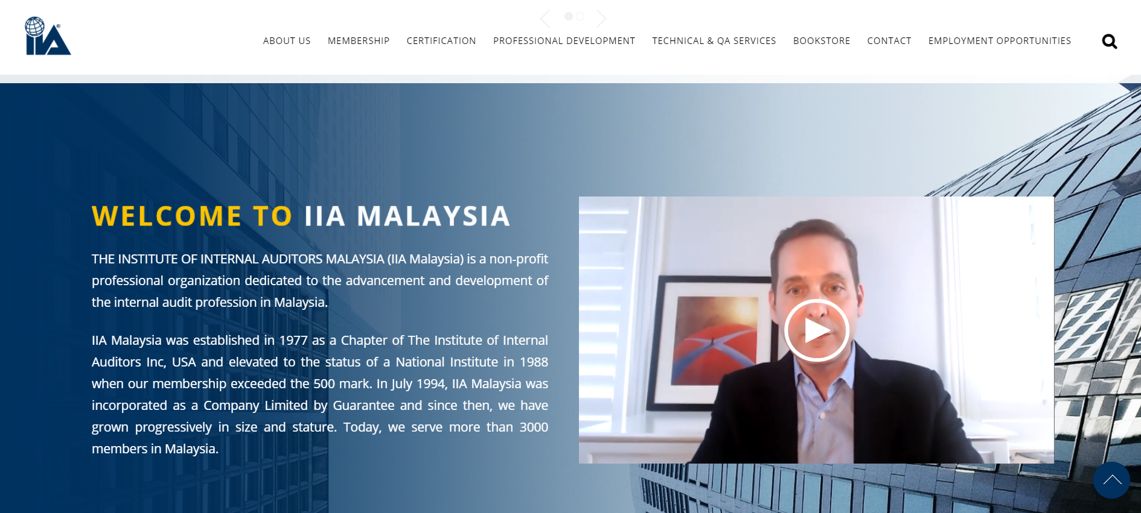
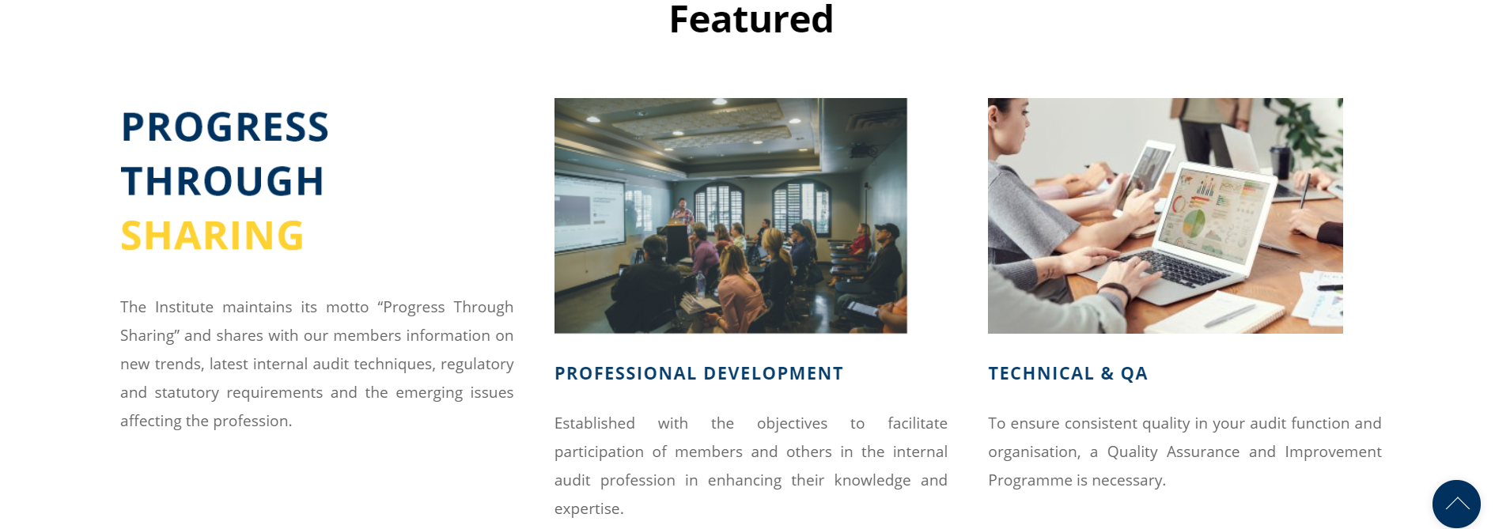
01.
What We Do?
The only channel for Internal Auditors.
Notes:
We are the only channel for Internal Auditors. Basically we provide services to Internal Auditors. Our nature same like others Professional bodies but we mainly focusing to Internal Audit.

Slide 5





Membership
Certification
Professional Development
Technical & Quality Assurance
Connect with Internal Auditors
Public Training
Virtual Training
In-House Training
Conference
To find out more guidance resources in areas such as Governance, Risk Management and Control in establishing an effective Internal Audit Function.
Notes:
We have 4 main services.
For professional development , we conduct 4 types of training public, virtual, inhouse and conferences.
This is where we develop, sharpen skill for internal auditor.
Technical & Publication.
Any related to technical issue such quality assurance.
This is the right place to get the guidance

Slide 6



MEMBERSHIP
Enables you to share in a collective wisdom of more than 218,000 members over 162 countries and territories. As an individual member of IIA Malaysia, you can enjoy a wide range of membership benefits and services
In Malaysia we serve more than 3000 members.
Notes:
We have 218,000 members around the world and in Malaysia we have serve more than 3000 members

Slide 7


TYPE OF INDIVIDUAL MEMBERSHIPS
Be A member!
01
02
03
04
s
STUDENT MEMBER
FELLOW MEMBER
ASSOCIATE MEMBER
PROFESSIONAL MEMBER
AUDIT COMMITTEE MEMBER
AIIA
CFIIA
Chartered Fellow Member of The IIAM
CACD
Associate Member of The IIAM
Chartered Audit Committee Director Member of The IIAM
CMIIA
Chartered Member of The IIAM
Notes:
So as you can see at the bottom. That’s are the designation that you can hold after your name.

Slide 8

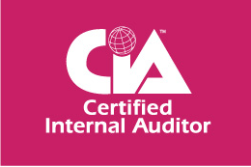


INDIVIDUAL MEMBERSHIP PROCESS
AIIA
AIIA
AIIA
CMIIA
CFIIA
Student
Associate
Associate
Professional
Fellow
Associate
Fellow
2nd or Final year Student
Employed and have less than 1 year experience
CMIIA - 10 years
5 years IA experience in Senior Position
Have rendered exceptional services in the areas of development, promotion and enhancement of the internal auditing profession and the Institute
Employed and have less than 1 year experience
2 years experience Internal Audit + Professional Certification
Employed and have less than 1 year experience
Notes:
You guys must be thinking, Why do I need membership and Professional Certificate?
1) To sharpen your internal Audit skill
2) This the only way to develop your Internal Audit career path.
3) Added value on your career because there is a lot of diploma, degree graduates out there that seeking for the job.
If they see that you have professional certificate the chances to win the job is high.

Slide 9




INDIVIDUAL MEMBERSHIP BENEFIT
Complimentary Networking Session
Discount on Educational Products
Access to Global Website and IA Journal
Exclusive member pricing for Trainings, Certification & Tuition Classes
Resource Centre
Internship Opportunity for Student Member
Notes:
What you will gain if you become our member?
1) Knowledge and informative talk that shared by experience speaker and can also connect with other internal auditor from various background

Slide 10
INTERNSHIP OPPORTUNITY
Requirements to apply:
Minimum 6 months of the Internship period required.
Submit latest CV, letter from University and photo Recognised Corporate Partner (RCP) at least 3 months prior to internship date.
Benefit being an Intern in IA fields
Guided learning to acquire knowledge and basic skills in IA
Wide range of experience working in well recognised Internal Audit organisations.
Notes:
This is one of benefit as a student. We have internship opportunity.
IIA Malaysia is the channel where you can seek for the internship especially in Internal Audit field.

Slide 11





Recognised Corporate Partner (RCP)
Explore IA Journey with them
Notes:
We have our own corporate member that have engaged to be part of our Recognised Corporate Partner (RCP) for this internship program. Currently we have Oriental Holdings Berhad, Sunway and also
Governace Advisory & Solutions Sdn Bhd. Where to get their information to submit your CV?

Slide 12
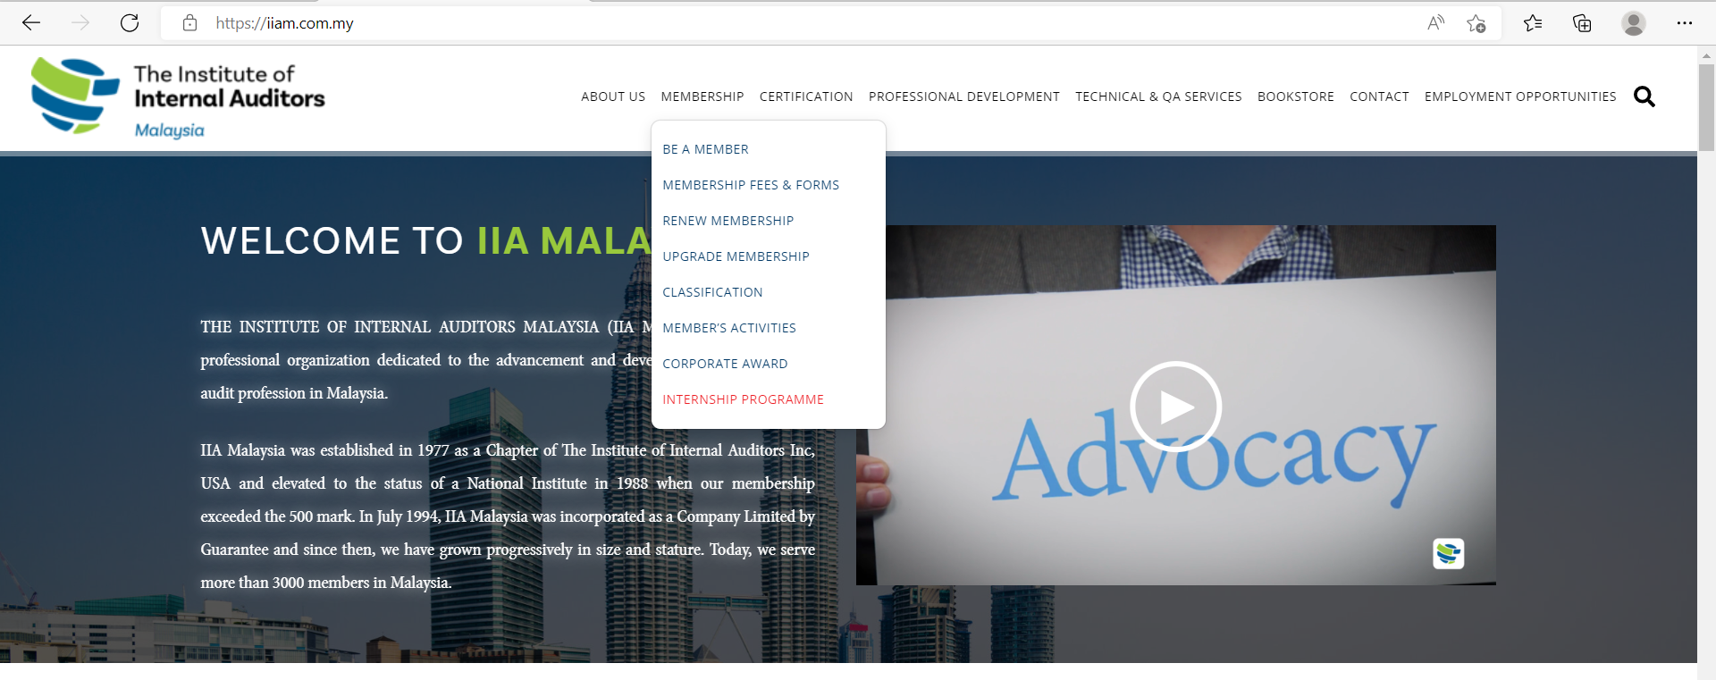

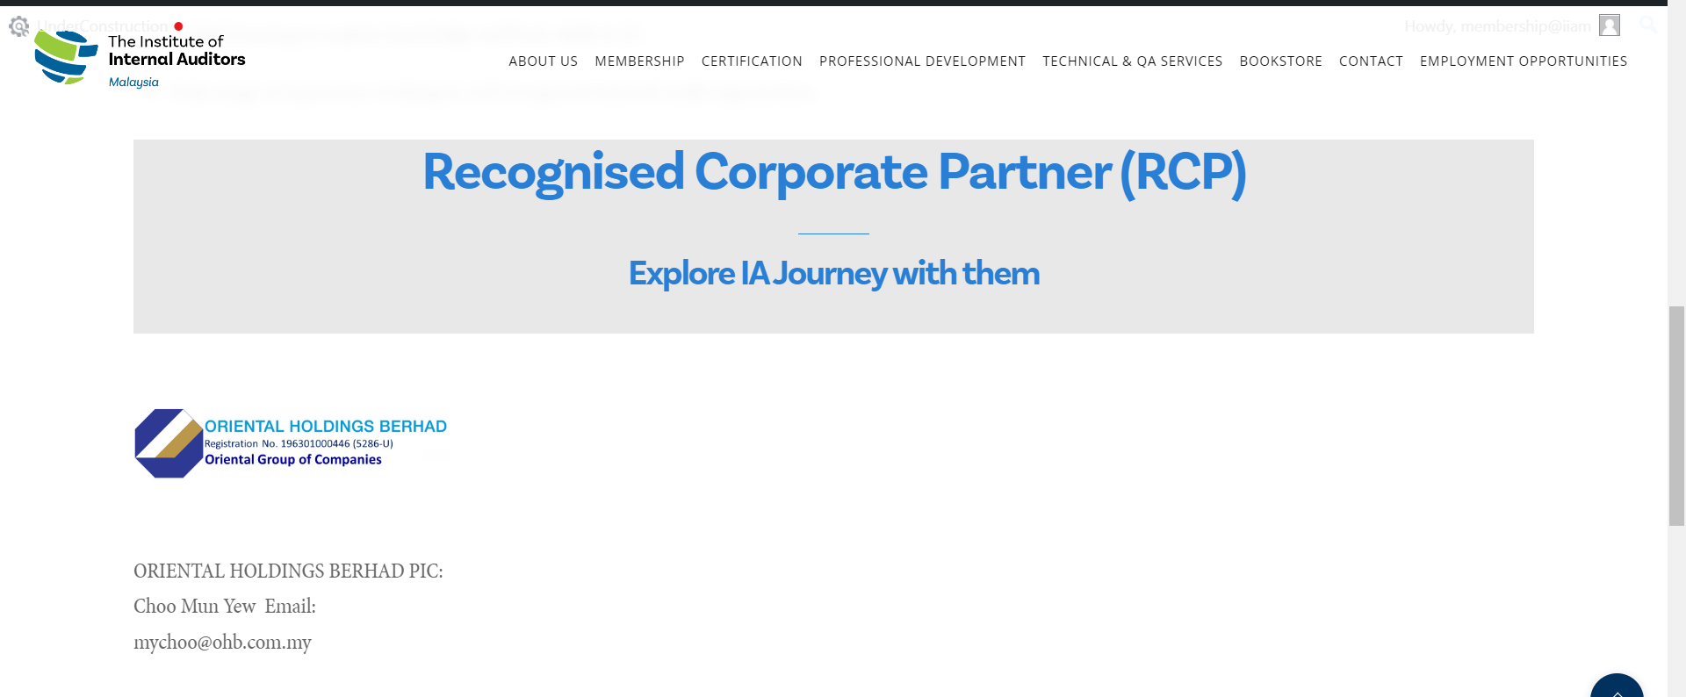
Recognised Corporate Partner (RCP)
Notes:
Where you can get the information. First you can go to IIAM website at iiam.com.my.
And then go to Membership and select Internship Program. In that page you will see all the information and requirement.
So if you scroll down, you will find our recognised corporate partner contact person and email to submit your resume.

Slide 13
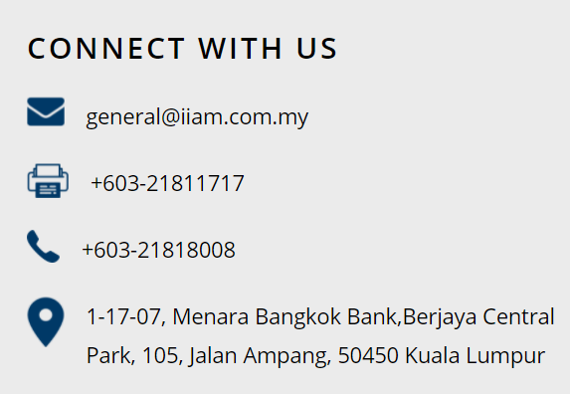

THANKS!
membership@iiam.com.my
certification@iiam.com.my

